Slide 1
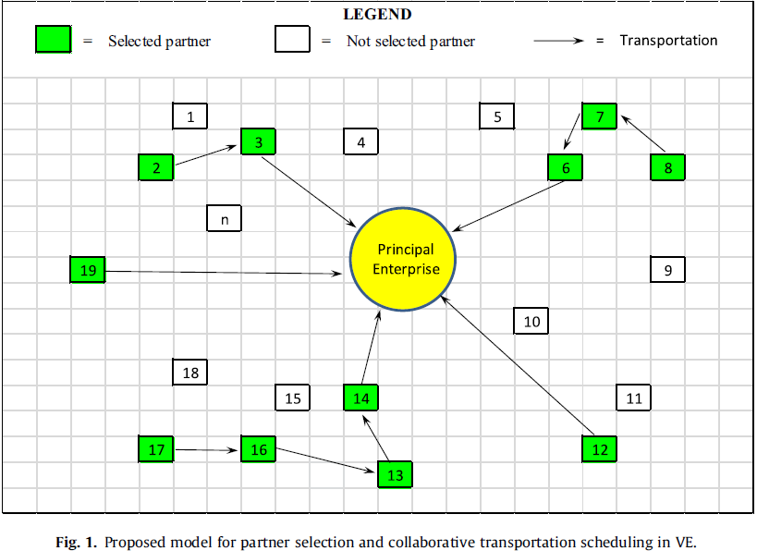

Partner Selection Optimization in Virtual Enterprises.
In real business world, customers demand better product with better technology all the time. Manufacturing enterprises may not have posses enough manpower or technology to meet all new requirements. But in order to employ more employee or build a new factory required high amount of extra cost. Not all enterprise can effort that amount of money. In order to deal with this problem, The virtual Enterprise was created.
The virtual enterprise is a temporary network of many enterprise created to deal with a specific project. After the project is conclude, this temporary network is dismissed. The project owner (some enterprise won a bid) can split a project into many sub project and choose to do some sub project by themselves and choose partners to help them complete other subproject. But in order to choose the right partners, there are many factors (Production cost, Risk, Transportation cost and etc.)that need to be considered. If a project is small, it maybe an easy task to select a partner. But most project required larger network across the globe lead to even more complex problems that require more computing power if they are using an old school decision making application. Also each project have different requirement so the member of the network have to be change to match the requirement. The Evolutionary algorithm provide less computing time and better solution for this kind of complex problems.
References.
Paper1: Optimisation of partner selection and collaborative transportation scheduling in Virtual Enterprises using genetic algorithm (GA). https://www.dropbox.com/s/6g54orwtrjtfdt0/Optimisation%20of%20partner%20selection%20and%20collaborative%20transportation.pdf?dl=0
Paper2: An adaptive quantum swarm evolutionary algorithm for partner selection in virtual enterprise (AQSEA). https://www.dropbox.com/s/05wo8gqipmtwpaz/An%20adaptive%20quantum%20swarm%20evolutionary%20algorithm%20forAn%20adaptive%20quantum%20swarm%20evolutionary%20algorithm%20for.pdf?dl=0
Paper3: Using multi-objective genetic algorithm for partner selection in green supply chain problems (MOGA). https://www.dropbox.com/s/jjgze7wpeft85uq/Using%20multi-objective%20genetic%20algorithm%20for%20partner%20selection%20in%20green%20supply%20chain%20problems.pdf?dl=0
Notes:
A list of procedures and steps, or a lecture slide with media.

Slide 2
Optimization Details.
Operators
Paper 1(GA): Both Mutation and Crossover is used to produce new generations but the paper did not provide any detail about the probability of Mutation and Crossover. The Mutation is done by randomly select 1 pair of genes in chromosome and swap their place. The Crossover is just simply copy first half of the chromosome from 1st parent and 2nd from another.
Paper 2(QEA): Custom Particle swarm optimization formula is used. The formula will randomly change the quantum angle in each Quebit resulted in new set of chromosome.
Paper 3(MOGA): Mutation operator and Crossover is used to produce new generations in the same as in paper 1. This paper compared two different algorithms called MOGA_1 and MOGA_2. Both of them use the same operator and encoding. The difference come from Selection step.
Encoding, Fitness and Selection.
Paper 1(GA): In the Partner Selection part, three-dimensional matrix with binary numbers is used to represents a solution. Number “1” means that partner is selected to work for specific project-subproject. And number “0” means that partner is not selected. The Fitness function is called objective function. It calculates a total cost of each solution in the generation and return a fitness value. The lower cost has better fitness. The selection method is dynamic ranking selection. A group of solutions is save.
Paper 2(AQSEA): Quantum angle is use to encode an initial population in a form of Q(t)={q1^{t}, q2^{t},…., qn^{t}}, each “qn^{t”} represented a chromosome(solution). A Chromosome contained a set of Quebits that can be interpret into a classical set of binary numbers by simple mathematical formula then use it as input for Fitness function. The Fitness function is objective function. It did the same as the 1st paper by calculate a total cost of a solution and return a fitness value. Number of cost factors are different. Only the best solution is save.
Paper 3(MOGA): Simple list of number that satisfied all constraints is use to represented a chromosome(solution). The Fitness function in this paper did the same as 2 papers above.
Results
Paper 1(GA): By combining Partner Selection with corroborative transportation scheduling then compare with 3 commercial solvers on Matlab, the solution produced 2.82% – 4.5% better solution (lower cost - better fitness).
Paper 2(AQSEA): Compared to other Swarm optimization and normal Quantum swarm optimization, the difference in term of computation speed is the same as other optimizations. The quality of solution for a large problem is slightly better than other optimizations.
Paper 3(MOGA): A comparison between MOGA_1 and MOGA_2 in this paper show that MOGA_1 is far superior than MOGA_2 in all terms(CPU times, number of solution and quality of solution).
Notes:
Beginning course details and/or books/materials needed for a class/project.

Slide 3
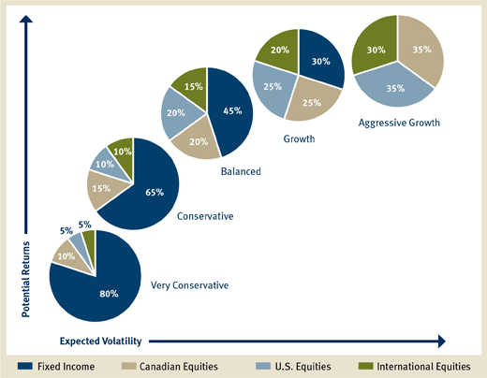
Portfolio Selection Problems.
Thousand of new projects are created everyday. Hundred of enterprise entered the market. Today a value of Gold is going down but tomorrow its might go up more than yesterday value. All of these changed lead to new or better opportunity to invest and gain more profit. Choosing things to invest is no simple task, wrong move can ruin your port or force your company to closedown.
In modern investment management, portfolio selection is about managing your limited resource and use it to gain maximum benefit with acceptable level of risk. Making decisions to invest in traditional way required lot of historical information combined with many other more factors. With just only in UK, There are more than 2,000 companies with in Stock market but in fact you probably don’t want to invest only in the stock market, you cloud buy gold, properties or invest in foreign countries around the world. As you can see making an optimal portfolio is a serious business.
Figure 1: Portfolio for Assets Management
References.
Paper1: A learning-guided multi-objective evolutionary algorithm for constrained portfolio optimization (MOEPO). https://www.dropbox.com/s/nsp6mrmo2hbsubk/A%20learning-guided%20multi-objective%20evolutionary%20algorithm%20for%20constrained%20portfolio%20optimization.pdf?dl=0
Paper2: Project Ranking Based Portfolio Selection Using Evolutionary Multi-objective Optimization (ESPRI). https://www.dropbox.com/s/f71ihragq2ij2ww/Project%20Ranking%20Based%20Portfolio%20Selection%20Using%20Evolutionary.pdf?dl=0
Paper3: A hybrid algorithm for constrained portfolio selection problems (PBILDE) https://www.dropbox.com/s/r1ge2bsvrjuuz8y/PBILDE.pdf?dl=0

Slide 4
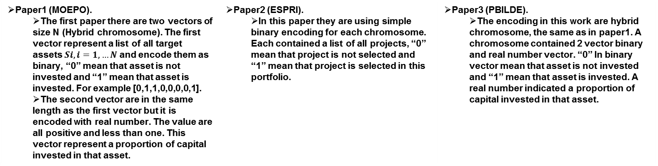
Optimization Details.
Encoding.
Paper1 (MOEPO). The first paper there are two vectors of size N (Hybrid chromosome). The first vector represent a list of all target assets $Si, i=1,…N$ and encode them as binary, “0” mean that asset is not invested and “1” mean that asset is invested. For example [0,1,1,0,0,0,0,1]. The second vector are in the same length as the first vector but it is encoded with real number. The value are all positive and less than one. This vector represent a proportion of capital invested in that asset. | Paper2 (ESPRI). In this paper they are using simple binary encoding for each chromosome. Each contained a list of all projects, “0” mean that project is not selected and “1” mean that project is selected in this portfolio. | Paper3 (PBILDE). The encoding in this work are hybrid chromosome, the same as in paper1. A chromosome contained 2 vector binary and real number vector. “0” In binary vector mean that asset is not invested and “1” mean that asset is invested. A real number indicated a proportion of capital invested in that asset.
Operators.
Paper1 (MOEPO). They did not talk directly about the operators but the there are evidence that they used Non-dominated Sorting Genetic Algorithm that used Mutation and Crossover operators with given probability. | Paper2 (ESPRI). The paper inspired by the same Non-dominated Sorting Genetic Algorithm as the first paper. Basically it use Mutation and Crossover operators with given probability. | Paper3 (PBILDE). There are 2 groups of operators in this paper the first group is only Mutation operator. This operator use to mutate a probability vector that will apply to the second group of operators. The second group of operators are Mutation and crossover which is controlled by the probability vector from the first group.
Results.
Paper1 (MOEPO). In this paper, they combined Non-dominated Sorting Genetic Algorithm with custom learning method(Their custom selection process). By comparing with several well known method such as Non-dominated Sorting Genetic Algorithm and Multi-objective evolutionary algorithm, their showed better performance. | Paper2(ESPRI). They did the test with the same project data from their reference (reference 12). The result show the quality of solution obtained with their method (Non-dominated Sorting Genetic Algorithm plus raking system and Impact model) are better. | Paper3 (PBILDE). The paper compare their propose solution several work from other research The result are various but mostly its did not perform well against the previous works.

